Slide 1
Towards Facilitating Empathic Conversations in Online Mental Health Support: A Reinforcement Learning Approach
Zelin Zhou 2021.5.12

Slide 2

WWW 2021 best paper

Slide 3
Outline
Introduction
Problem Definition
Methodology
Experiments
Conclusion

Slide 4
Outline
Introduction
Problem Definition
Methodology
Experiments
Conclusion

Slide 5

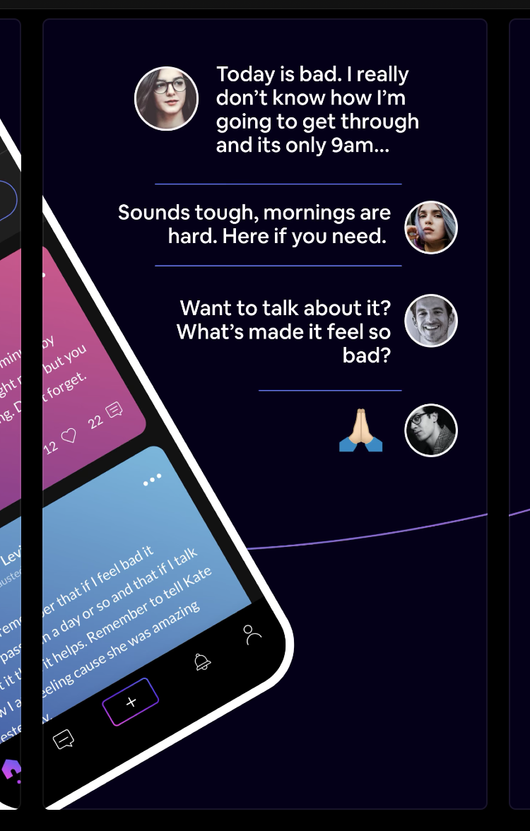
Introduction
Web-based mental
Health conversation:
Improve access to
Treatment
Reduce global
disease burden
🙊Empathy counts
Notes:
As we know, people nowadays overwhelmed with stresses from work and life often seeks help from online platforms.
(read)
- (click) Empathy plays an important role in Online Mental Health conversations.
- Expert have repeatedly demonstrated that empathy, the ability to understand and feel the emotions and experiences of others, is a key component leading to positive outcomes in supportive conversations

Slide 6
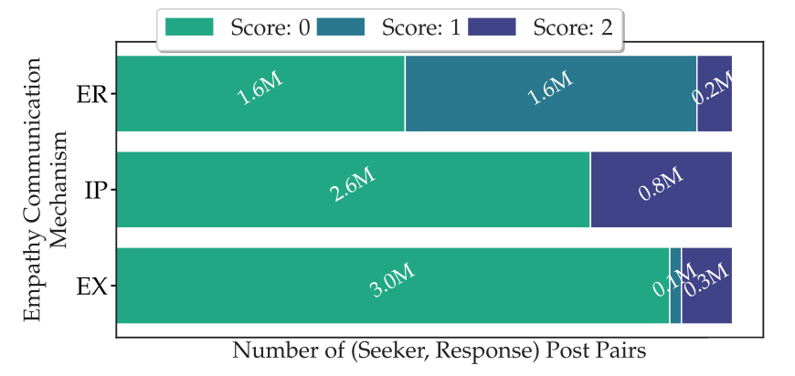
However
Recent studies have shown that:
highly empathic(共情的) conversations are rare in online mental health platforms
Statistics in TalkLife dataset
Notes:
﻿- However (read)

Slide 7
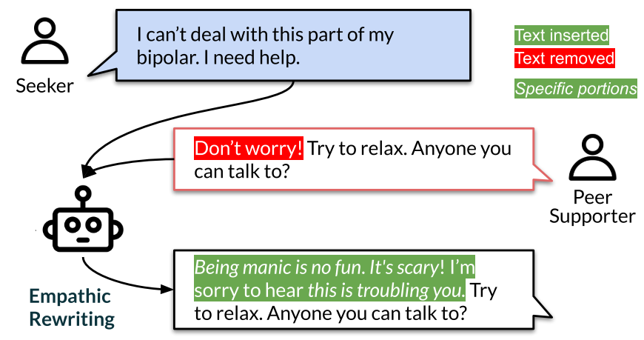
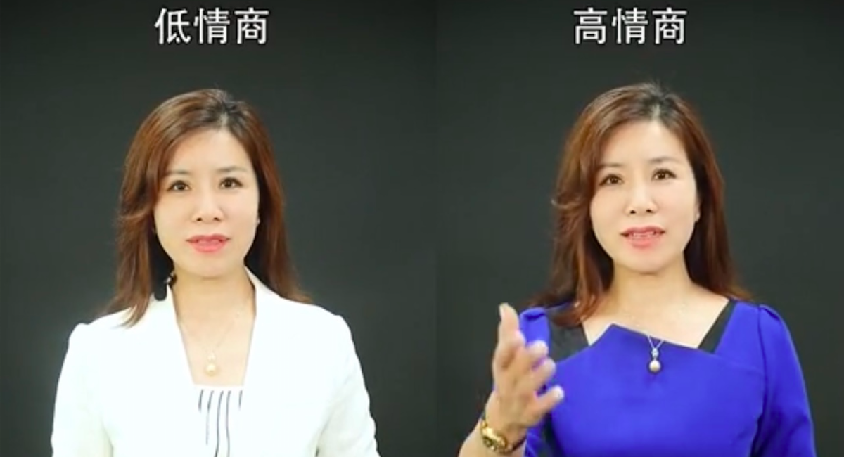
Task definition
bipolar (躁郁症)
manic (躁狂）
Empathic Rewriting
a new task that aims to transform low-empathy conversational posts to higher empathy
Notes:
Take an example
(click)(read)
Response with relative low empathy would say that
Actually this sentence is not bad, expressing appopriate careness. However, it might be too universal, unrelated to the specific context, or say, not empathic. imagine I say “I want to commit suicide”… It is problematic
Let’s rewrite this response to get relative high empathy

Slide 8
Comparison
Original:
"Don’t worry! Try to relax. Anyone you can talk to?”
Insertion:
Being manic is no fun. It’s scary
understanding of feelings and experiences
I’m so sorry to hear this is troubling you
display of felt emotions

Slide 9
Challenges
Empathy is a complex, conceptually nuanced construct
Rewriting should not undermine other conversation goals like language fluency, context specificity, and diversity
“Scary it is manic being” ❌ ungrammatical
“I understand how you feel” ❌ Too general
Notes:
requires understanding the feelings and experiences shared by the support seeker.
Take two counter examples

Slide 10
Challenges
Beyond word-level transformations —— often requiring multiple new sentences to be added or replaced
Style transfer:
"the movie was good” " the movie was bad”
4. No large dataset available

Slide 11
Dataset
TalkLife platform
manually annotate ∼3k posts : "Is this mental health related?”
Train a standard text classifier on annotated posts and apply it to the entire TalkLife dataset
Collect 3.33M interactions from 1.48M seeker posts
Empathic posts
Computational labeling For warm-start supervised training
Emotional Reactions (warmth, compassion)
Interpretations (understanding of feelings and experiences)
Explorations (exploring feelings and experiences)
Human experts rewrite response For evaluation

Slide 12
Outline
Introduction
Problem Definition
Methodology
Experiments
Conclusion

Slide 13
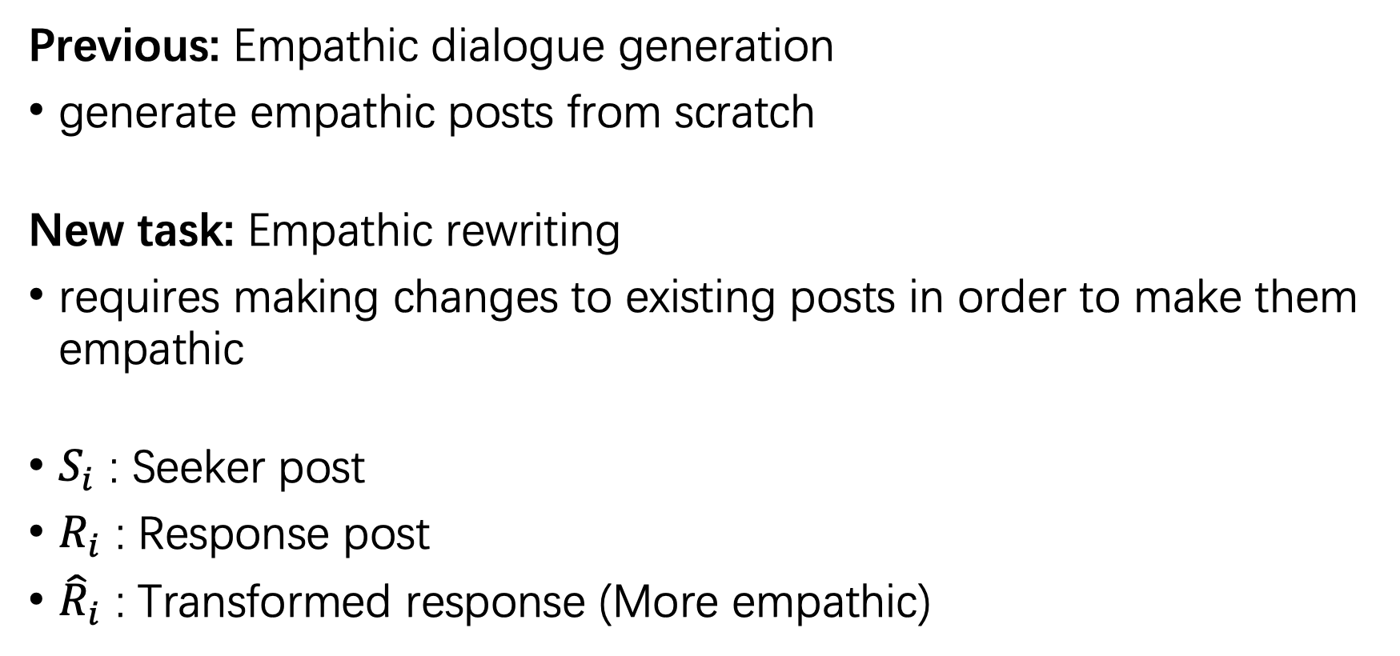
Empathic Rewriting
Previous: Empathic dialogue generation
generate empathic posts from scratch
New task: Empathic rewriting
requires making changes to existing posts in order to make them empathic
$S_{i}$ : Seeker post
$R_{i}$ : Response post
${\hat{R}}_{i}$ : Transformed response (More empathic)

Slide 14
Goals
For the system:
Theoretically-grounded empathy
Context specificity and response diversity
Text fluency and sentence coherence
For real life applications:
Rewriting for feedback and training
Help those conducting online mental health support

Slide 15
Outline
Introduction
Problem Definition
Methodology
Experiments
Conclusion

Slide 16
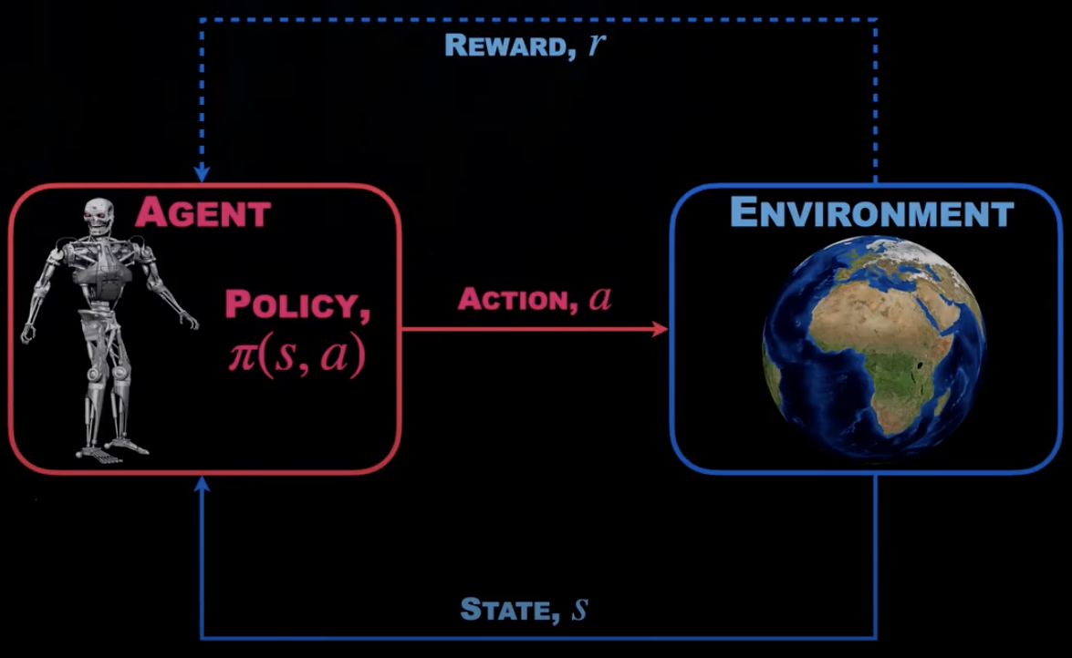
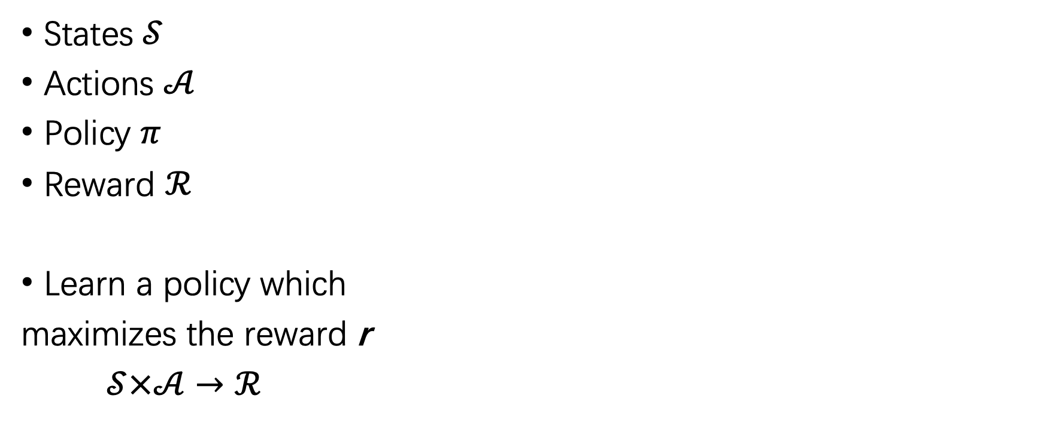
Reinforcement Learning Recap
States $𝒮$
Actions $𝒜$
Policy $π$
Reward $ℛ$
Learn a policy which
maximizes the reward r
$𝒮×𝒜→ℛ$
Notes:
- RL can be seen as a Sweet point between Machine Learning and Control Theory
- There are four fundamental concepts in RL
- (read)
- In reinforcement learning, the robot(or say agent) should continuously interact with the environment.
- Following a certain policy (or say strategy), the agent moves from state S and takes action A to interact with the environment and get some feedback(or say reward)

Slide 17
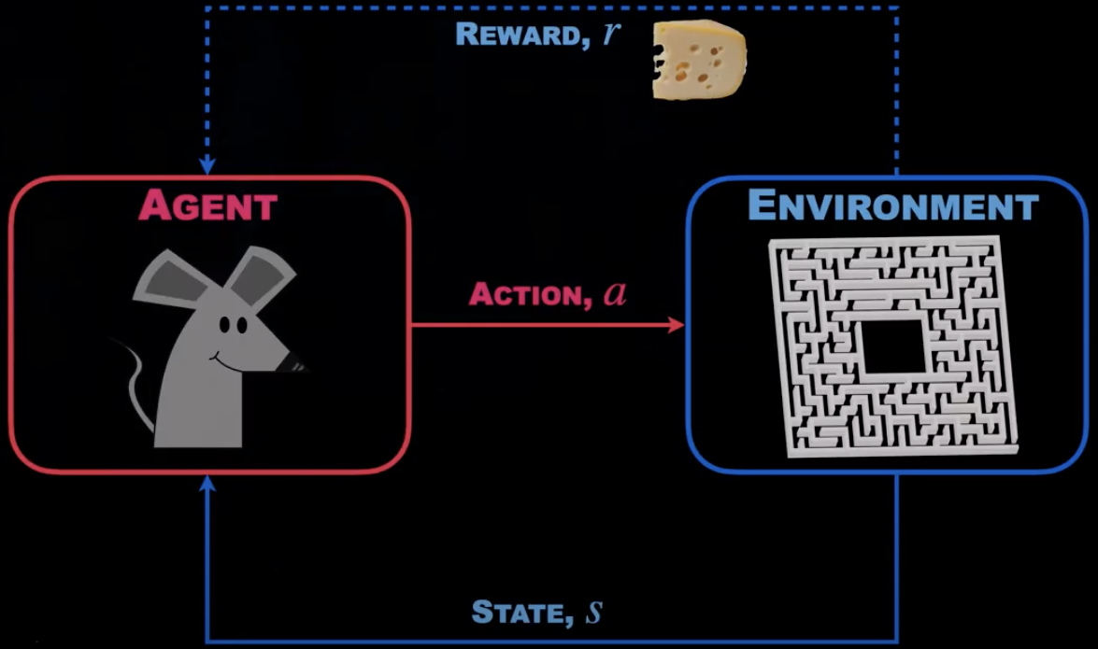
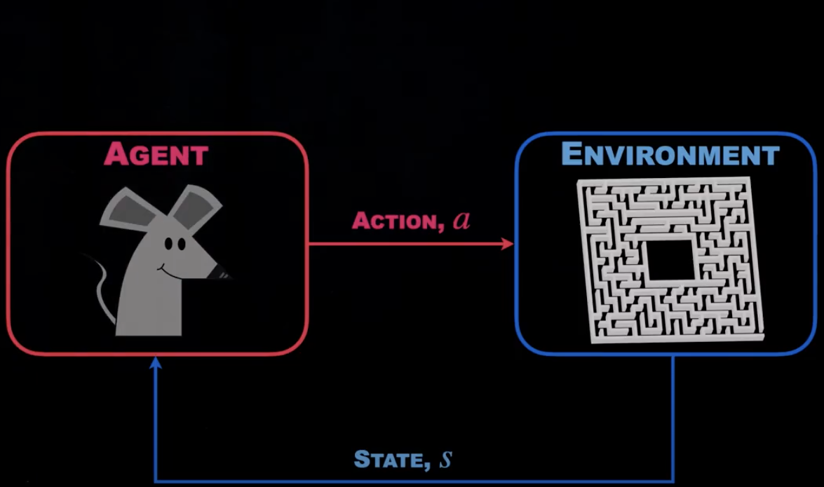
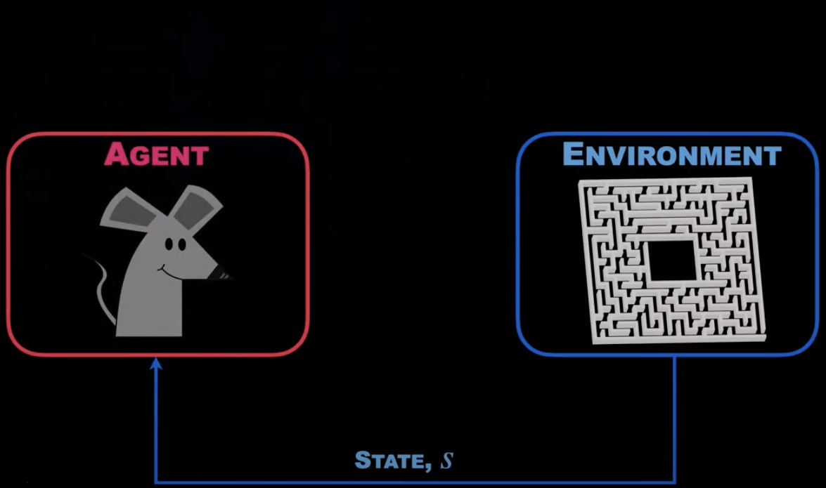
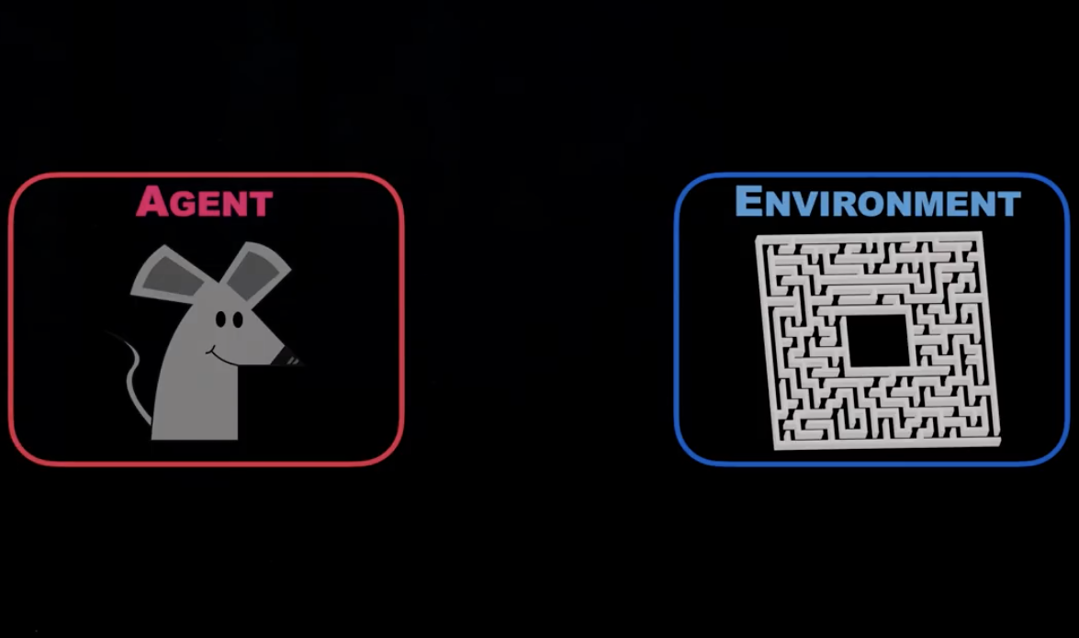
Reinforcement Learning Recap
Sparse reward
States $𝒮$
Actions $𝒜$
Policy $π$
Reward $ℛ$
Learn a policy which
maximizes the reward r
$𝒮×𝒜→ℛ$
Q1: Dense reward?
After every move, tell him if its right or wrong
Notes:
- (click)Take the mouse in a maze as an example
- Here the agent is the mouse, the environment is a maze.
- (click)The mouse gets to measure its current state S in the environment which is his current position. Note that the whole maze is unseen to the mouse, but he could remember where he has already been through, which is his previous states.
- (click)Then the mouse needs to take some actions whether to go forward or backward, this direction or that direction.
- (click)In the very end of the game, the mouse will crack the maze and get his reward——a piece of cheese.
- So we can see the reward is very sparse, only in the end can we get positive feedback from the environment.
- A natural idea is that we give dense reward at each step, to tell the mouse whether this action is right or wrong.
- So, in the design of a reinforcement framework, a good reward function is the key to train an efficient model.

Slide 18
Reinforcement Learning Framework
Recap what our agent needs to do:
On seeker post: leverages context from the seeker post
On original response: looks for areas where empathy could be improved
On generation: fluent, coherent, specific, and diverse
Moreover:
Make minimal changes
(learning a“stopping”action)
Notes:
- Let's come back to our empathic rewriting task
- (read)
- (click)
- (click)
- which it uses for making specific empathic changes
- (click)

Slide 19
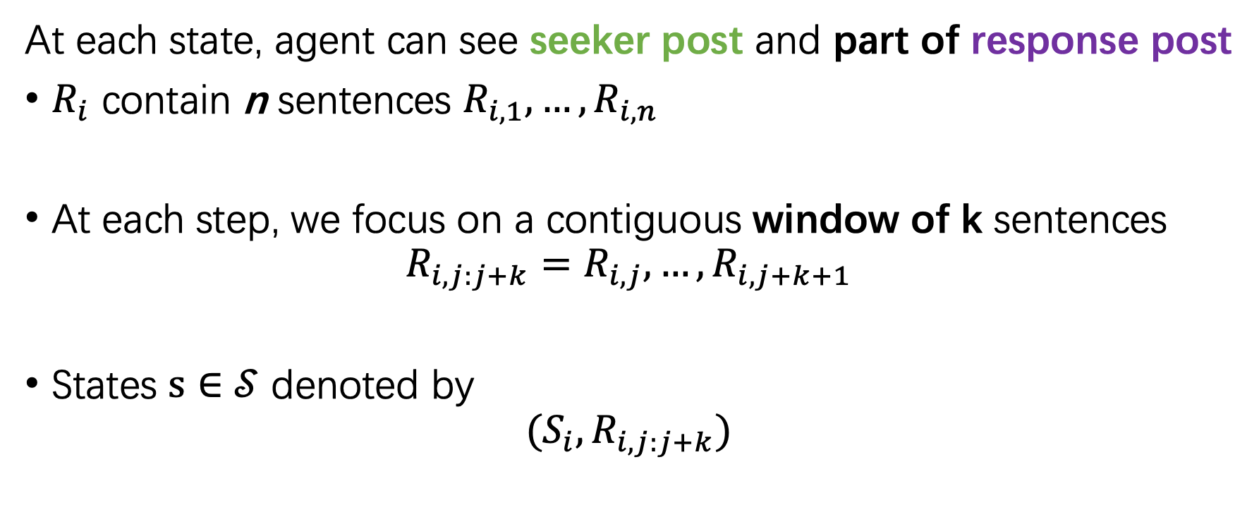
State: seeker post & fixed-length contiguous spans of response post
At each state, agent can see seeker post and part of response post
$R_{i}$ contain n sentences $R_{i,1}, …, R_{i,n}$
At each step, we focus on a contiguous window of k sentences
$$R_{i,j:j+k}=R_{i,j}, …, R_{i,j+k+1}$$
States $s∈𝒮$ denoted by
$${{(S}_{i}, R}_{i,j:j+k})$$
Notes:
Concatenated with a <split> token, which is a common practice in bert-like models

Slide 20
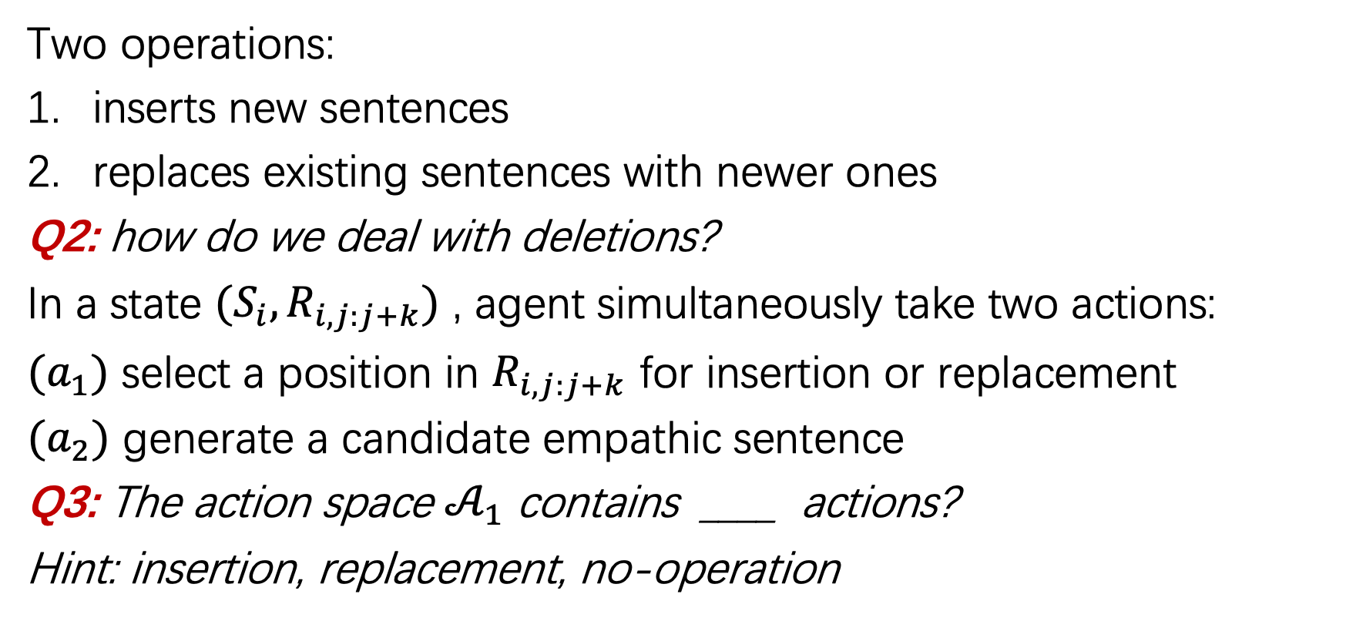
Actions: sentence-level edits
Two operations:
inserts new sentences
replaces existing sentences with newer ones
Q2: how do we deal with deletions?
In a state ${{(S}_{i}, R}_{i,j:j+k})$ , agent simultaneously take two actions:
$(a_{1})$ select a position in $R_{i,j:j+k}$ for insertion or replacement
$(a_{2})$ generate a candidate empathic sentence
Q3: The action space $𝒜_{1}$ contains ____ actions?
Hint: insertion, replacement, no-operation

Slide 21
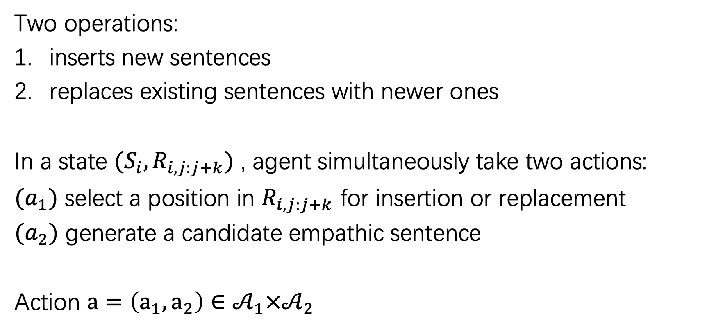
Actions: sentence-level edits
Two operations:
inserts new sentences
replaces existing sentences with newer ones
In a state ${{(S}_{i}, R}_{i,j:j+k})$ , agent simultaneously take two actions:
$(a_{1})$ select a position in $R_{i,j:j+k}$ for insertion or replacement
$(a_{2})$ generate a candidate empathic sentence
Action $a=\left(a_{1},a_{2}\right)∈𝒜_{1}×𝒜_{2}$

Slide 22
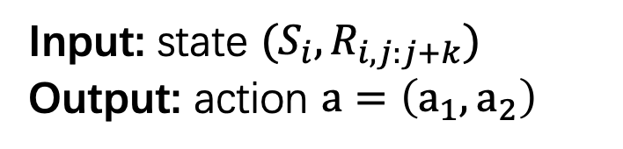
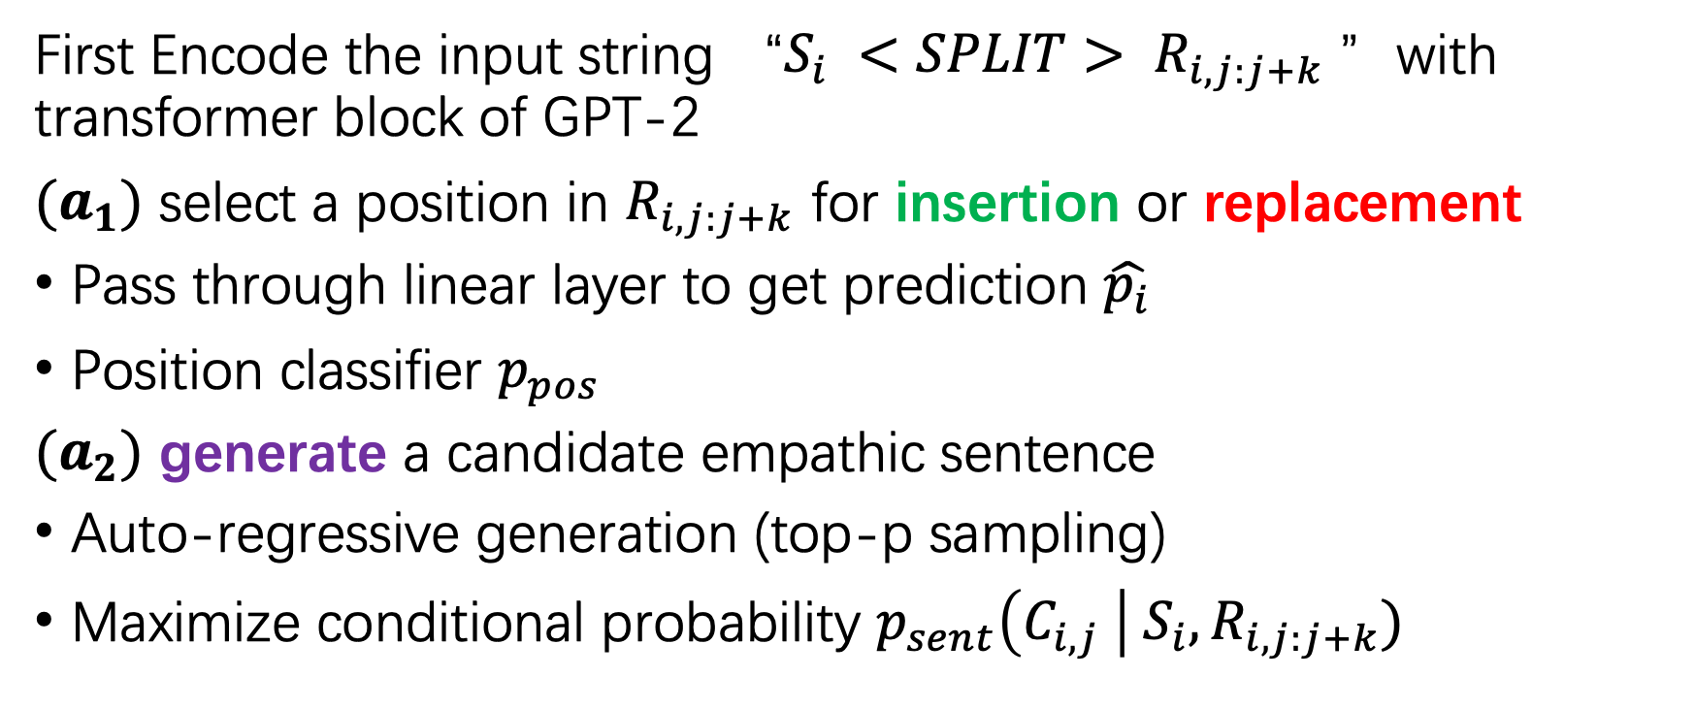
Policy
Input: state ${{(S}_{i}, R}_{i,j:j+k})$
Output: action $a=\left(a_{1},a_{2}\right)$
First Encode the input string “${S_{i} <SPLIT> R}_{i,j:j+k}$ ”with transformer block of GPT-2
$(a_{1})$ select a position in $R_{i,j:j+k}$ for insertion or replacement
Pass through linear layer to get prediction $\hat{p_{i}}$
Position classifier $p_{pos}$
$(a_{2})$ generate a candidate empathic sentence
Auto-regressive generation (top-p sampling)
Maximize conditional probability ${{p_{sent}\left(C_{i,j} \right| S}_{i}, R}_{i,j:j+k})$

Slide 23
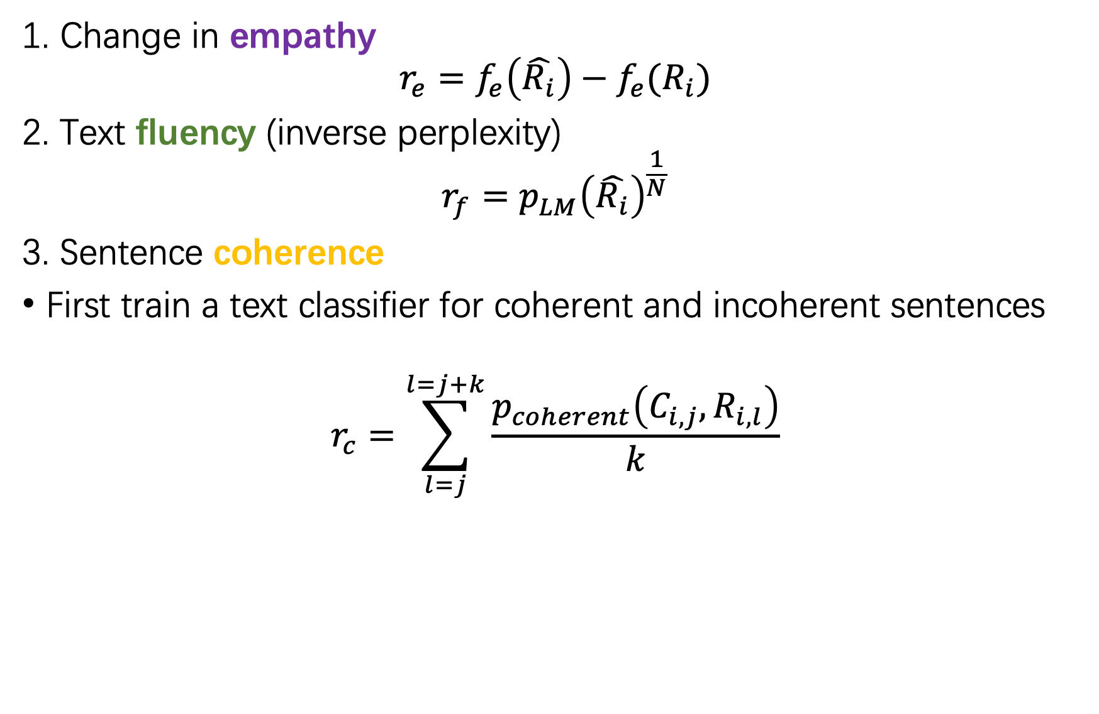
Rewards
1. Change in empathy
$$r_{e}=f_{e}\left(\hat{R_{i}}\right)−f_{e}(R_{i})$$
2. Text fluency (inverse perplexity)
$$r_{f}=p_{LM}^{}{\left(\hat{R_{i}}\right)}^{\frac{1}{N}}$$
3. Sentence coherence
First train a text classifier for coherent and incoherent sentences
$$r_{c}=\sum_{l=j}^{l=j+k}{\frac{p_{coherent}\left(C_{i,j},R_{i,l}\right)}{k}}$$
Q4: why inverse?
Notes:
3. For every pair of candidate sentence and sentence in the k window, we classify whether they are coherent or not, and take the average as the reward.

Slide 24
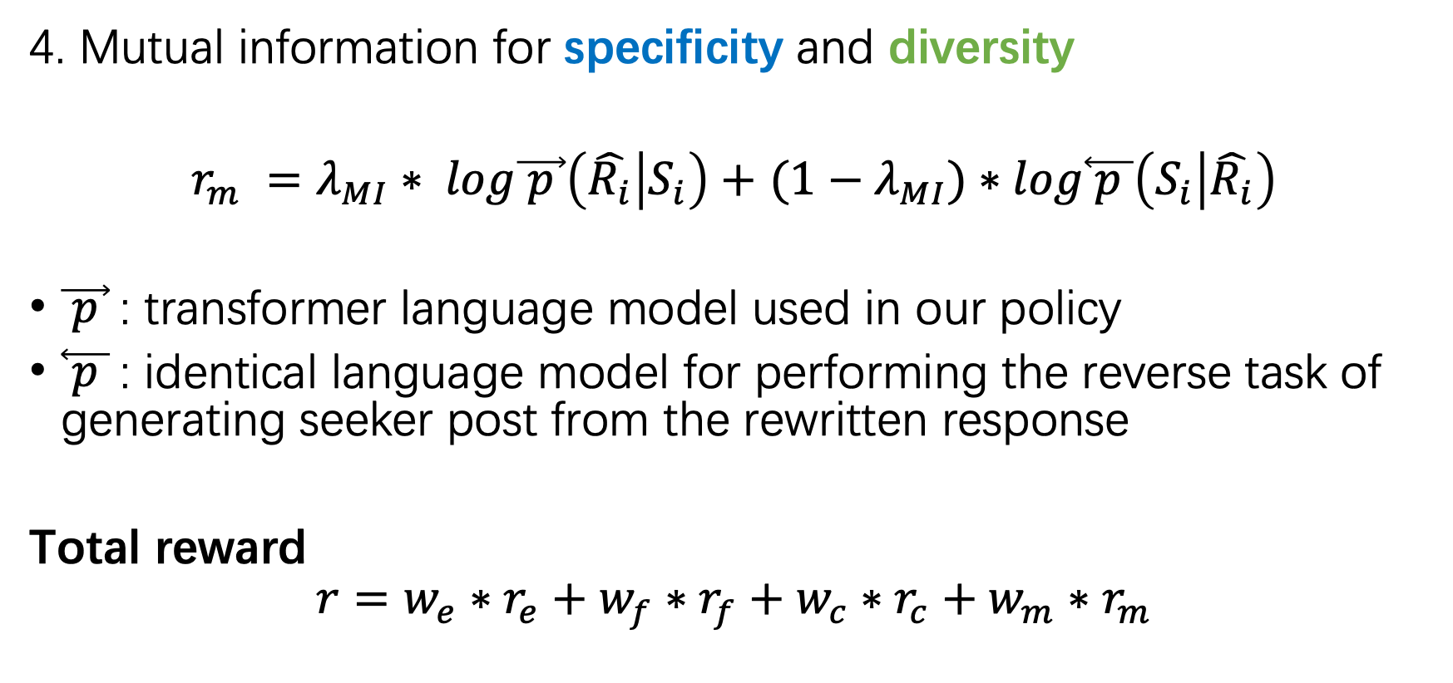
Rewards
4. Mutual information for specificity and diversity
$﻿r_{m} =λ_{MI}∗ log\vec{ p }\left(\hat{R_{i}} | S_{i}\right)+$ ${(1−λ}_{MI})∗log\overset{⃖}{ p }\left(S_{i} | \hat{R_{i}}\right)$
$\vec{ p }$: transformer language model used in our policy
$\overset{⃖}{ p }$: identical language model for performing the reverse task of generating seeker post from the rewritten response
Total reward
$$r=w_{e}∗r_{e}+w_{f}∗r_{f}+w_{c}∗r_{c}+w_{m}∗r_{m}$$

Slide 25
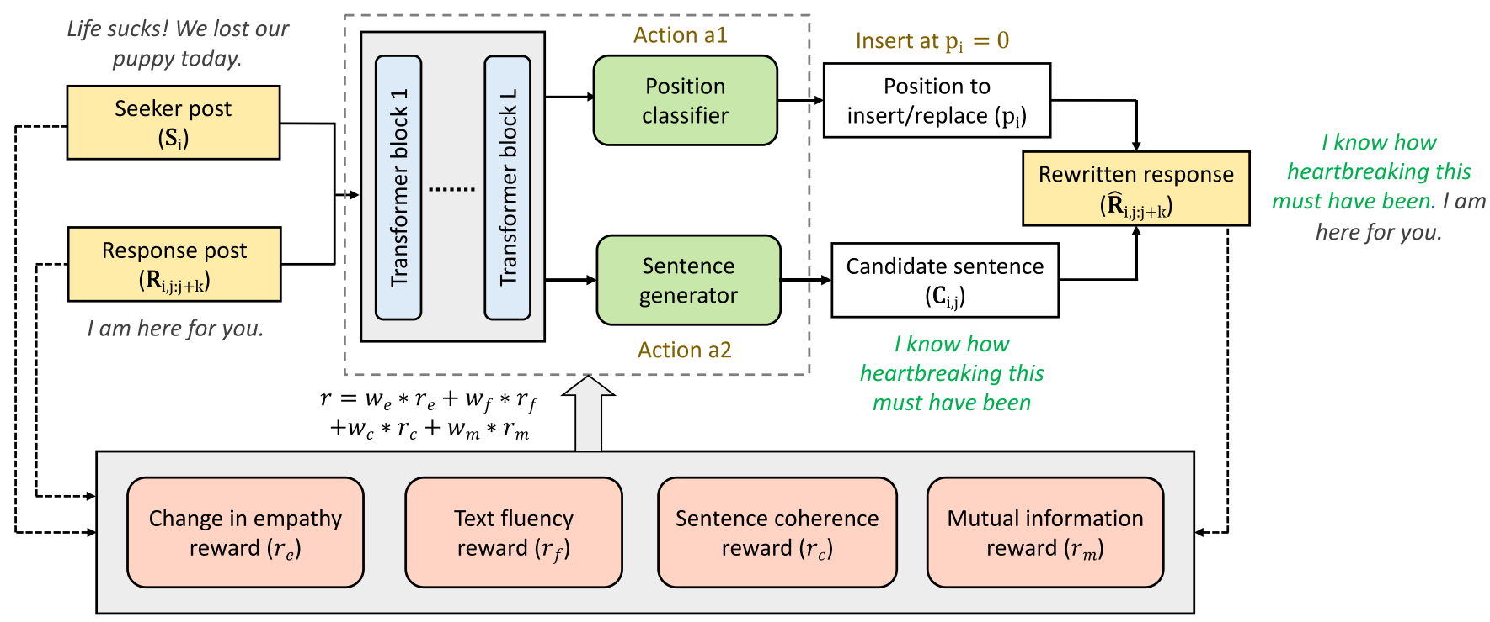
Notes:
- Let's have a look at the whole pipeline of reinforcement learning framework

Slide 26
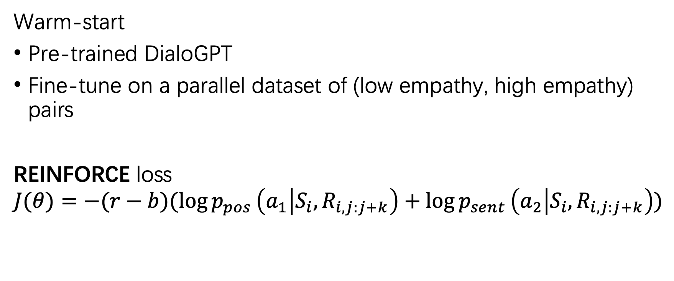
Optimization and training
Warm-start
Pre-trained DialoGPT
Fine-tune on a parallel dataset of (low empathy, high empathy) pairs
REINFORCE loss
$$J(θ)=−(r−b)(\log{p_{pos}}\left(a_{1} | S_{i},R_{i,j:j+k}\right)+\log{p_{sent}}\left(a_{2} | S_{i},R_{i,j:j+k}\right))$$
Avg(previous 100 reward)
action 1
action 2
Notes:
2. This is a common practice in reinforcement learning for stabilizing training

Slide 27
Outline
Introduction
Problem Definition
Methodology
Experiments
Conclusion

Slide 28
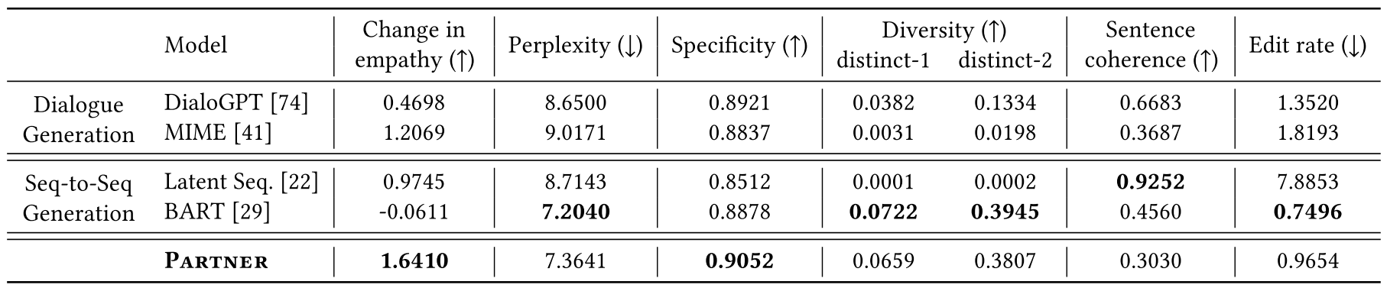
Experiments
MIME: An empathic dialogue generation model
completely disregard the original response

Slide 29
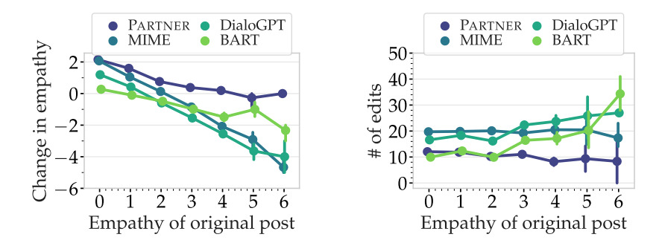
Analysis
Notes:
- Partner and MIME are effective at increasing empathy in zero-empathy responses. However, Partner is more effective in increasing empathy in low, non-zero empathic responses and doesn’t make an already empathic post worse.
- Partner makes lesser number of changes compared to baselines. The changes are relatively more for less empathic responses which also tend to be shorter.

Slide 30
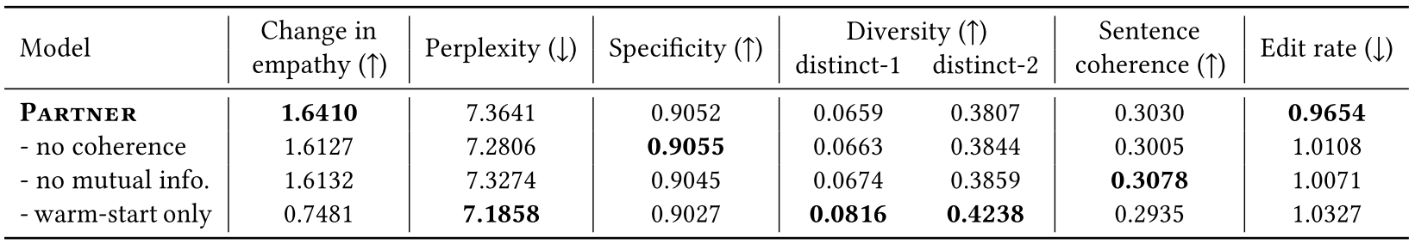
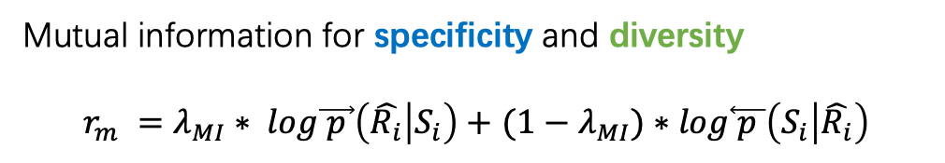
Ablation
Mutual information for specificity and diversity
$﻿r_{m} =λ_{MI}∗ log\vec{ p }\left(\hat{R_{i}} | S_{i}\right)+$ ${(1−λ}_{MI})∗log\overset{⃖}{ p }\left(S_{i} | \hat{R_{i}}\right)$
No RL training

Slide 31
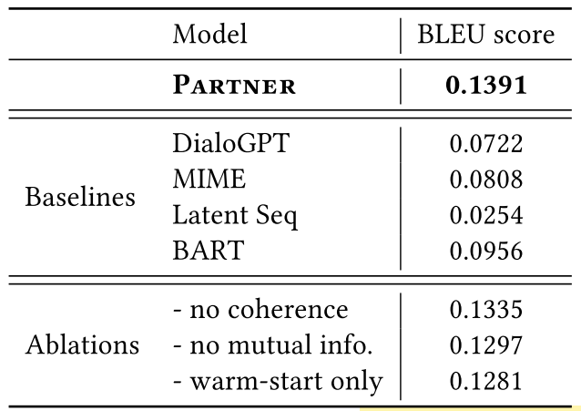
human written evaluation set

Slide 32
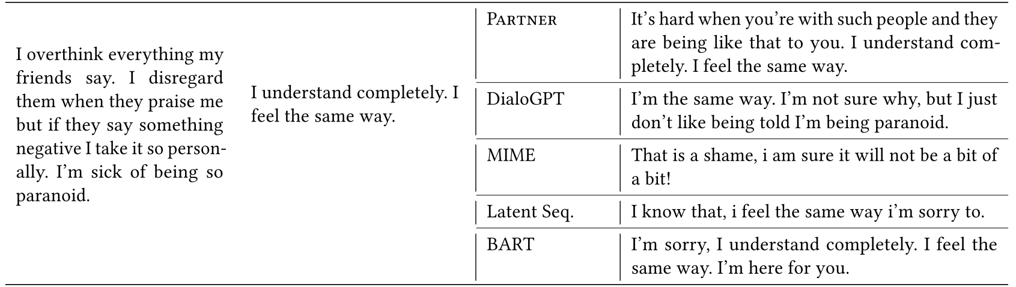
Qualitative examples

Slide 33
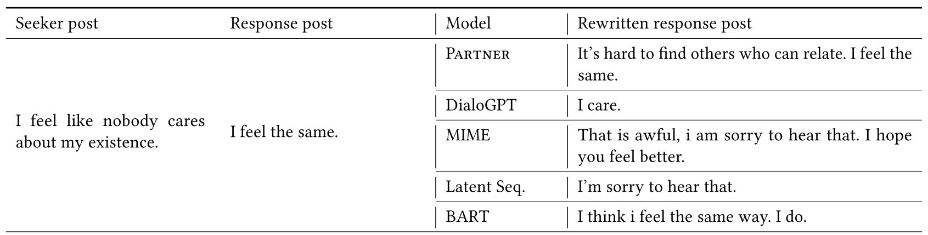
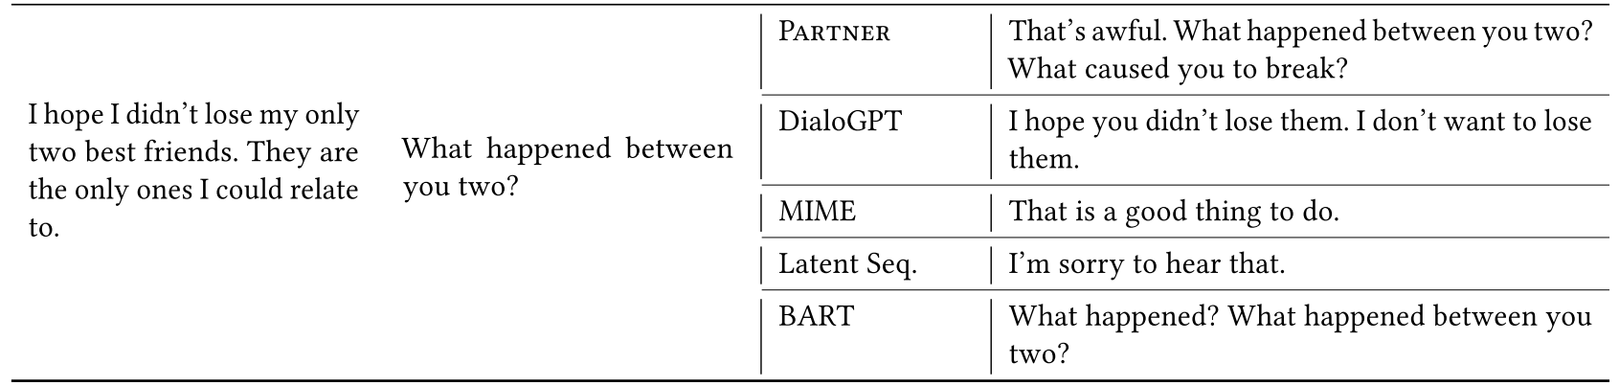

Slide 34
Outline
Introduction
Problem Definition
Methodology
Experiments
Conclusion

Slide 35
Conclusion
Propose a new task of empathic rewriting
Develop and train Partner, a reinforcement learning model which makes sentence-level edits to posts for making them empathic.
best paper enough?

Slide 36
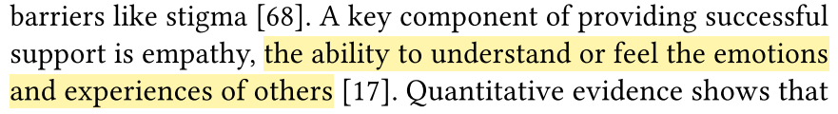
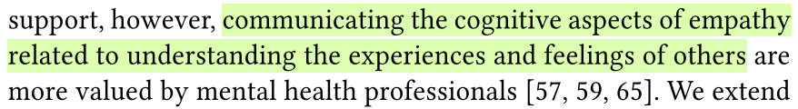
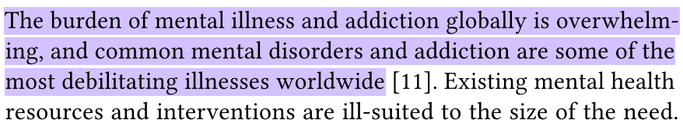
Discussion
1. Good topic & Humanistic Care

Slide 37
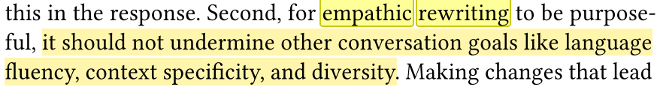
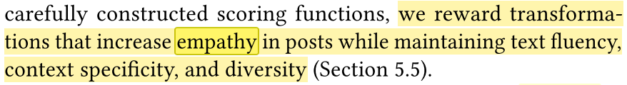
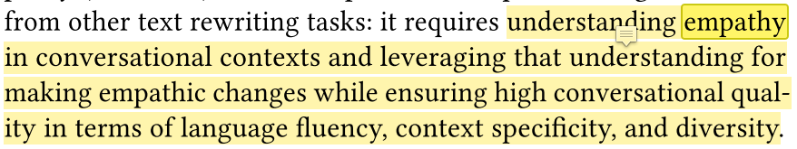
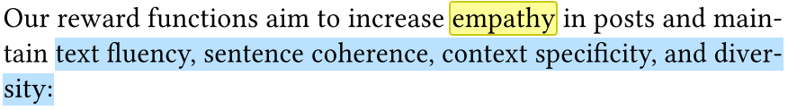
Discussion
2. Story telling
Repetition & Emphasizing core idea

Slide 38
Discussion
2. Story telling
Always indicating this is challenging

Slide 39
Thanks!

